Slide 1

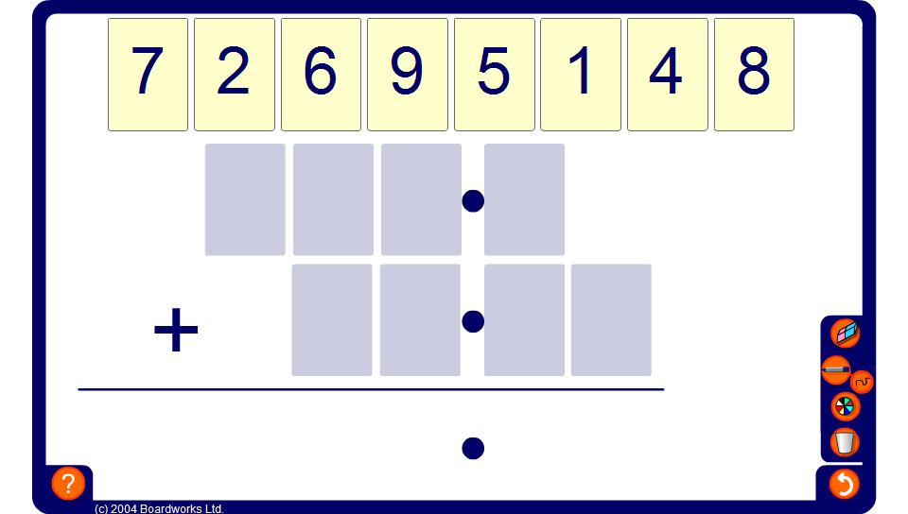


Sums and differences
Notes:
Ask pupils how we could use the digit cards to make the largest sum possible. Discuss strategies and check the answer by clicking on the show answer key.
Now, ask how we could make the smallest sum possible. Again, discuss strategies and check the answer by clicking on the show answer key.
Repeat the activity to find the largest difference possible and the smallest difference possible.

